Slide 1
Multi-Cloud FinOps Optimization System Proposal Presentation
REVA Academy for Corporate Excellence (RACE)
Name: Aakif Shaikh
Program: M.Sc. in Cloud Architecture and Security
Batch: CAS04
SRN: R24DI005
Date: 19/07/2026
Capstone 1
race.reva.edu.in

Slide 2
Agenda
01
Introduction
05
Project Methodology
Background | Current status | Why this study
Conceptual Framework | Research Design
02
Literature Review
06
Proposed Solution
Seminal works | Summary | Research Gap
Solution Approach | Expected Outcome
03
Problem Statement
07
System Requirements
Technical/Functional Problem
Software & Hardware Architecture | Data & Security Standards
04
Project Objectives
08
Detailed Scope of Work
Primary & Secondary Objectives | Expected Outcome
Implementation Phases
09
References
Journal Articles | White Papers

Slide 3
Background Information
Background: Modern enterprise environments deploy a strategic mix of AWS and Azure infrastructure to maximize resilience and prevent single-vendor lock-in. However, both providers natively generate billing metrics in highly nested, proprietary NoSQL-style JSON schemas with conflicting naming conventions.
Current Status: Engineering and operational teams currently rely on manual data cleaning and fragmented local spreadsheets to reconcile cross-cloud utilization. Meanwhile, commercial enterprise FinOps tools remain inaccessible due to high third-party licensing fees.
Why This Study: This project addresses these gaps by engineering a serverless, zero-infrastructure-cost automation utility. It dynamically flattens multi-cloud data pipelines into a unified relational schema to eliminate manual overhead and instantly expose underutilized compute commitments.

Slide 4
Literature Review
No. | Title | Author and Year | Journal | Description | Insights | Research Gaps / Comments
1 | Automated Cloud Cost Optimization: A Systematic Literature Review | M. S. de Brito, A. Hoeller, and T. M. Sucha (2023) | IEEE Access | Synthesizes existing automated cloud cost management frameworks and algorithmic optimization strategies. | Emphasizes that programmatic cost reduction prevents rate leakage better than manual tracking. | Relies heavily on high-level frameworks; lacks practical, zero-cost serverless pipelines for multi-cloud automation.
2 | Governance Frameworks for Multi-Cloud and Hybrid Cloud Topographies | S. Dustdar, S. N. Srirama, and A. M. El-Rify (2022) | IEEE Cloud Computing | Evaluates unified governance layers designed to handle architectural silo challenges in multi-cloud setups. | Demonstrates that standardizing disparate vendor metrics into a single tier eliminates operational overhead. | Focuses on high-level policies without implementing unified, open data schemas (like FOCUS) for cost reporting.

Slide 5
Literature Review
No. | Title | Author and Year | Journal | Description | Insights | Research Gaps / Comments
3 | Event-Driven Serverless Architectures for Near Real-Time Infrastructure Compliance Verification | Y. Ju, V. C. M. Leung, and X. Wang (2023) | IEEE Transactions on Services Computing | Analyzes event-driven, serverless architectures used for rapid, low-cost compliance checking. | Proves that serverless routines achieve near real-time auditability without incurring idle compute costs. | Geared strictly toward security compliance; does not apply serverless execution to automated FinOps ingestion pipelines.
4 | Critical Analysis of Vendor Lock-In Strategies and Resource Lineage in Multi-Cloud Governance | J. Opara-Martins, R. Sahandi, and F. Tian (2020) | IEEE Systems Journal | Explores resource lineage tracking to protect organizations against cloud vendor lock-in risks. | Highlights that lack of granular visibility into cross-cloud asset dependencies leads to economic waste. | Explores the problem theoretically; lacks a lightweight ETL pipeline and reactive dashboard for small-scale deployments.

Slide 6
Problem Statement
Technical Problem
Schema Disparities & Ingestion Overhead: Cloud providers generate utilization datasets in incompatible, highly nested, proprietary NoSQL-style JSON schemas. Reconciling these without automated ETL pipelines causes immense data-cleaning overhead.
Architecture Cost Inflation: Standard cloud data warehouse deployments introduce high base infrastructure and compute costs, contradicting the foundational goal of cost optimization.
Functional Problem
Commitment Underutilization: Organizations lose significant cost-saving opportunities because unused cloud reservations and savings plans fail to align dynamically with active workloads.
Financial Rate Leakage: The inability to map cross-cloud billing data under a unified model leads to systemic over-billing and undetected operational waste.

Slide 7
Project Objectives
Objective: To architect and deploy a secure, serverless Multi-Cloud FinOps Optimization System that automatically ingests, normalizes, and reconciles heterogeneous AWS and Azure billing datasets into a unified schema using the FOCUS framework—all running within a zero-infrastructure-cost tier.
Automated Data Processing: Build an event-driven ingestion pipeline using Azure Functions and Python/Pandas to eliminate manual data-cleaning and spreadsheet overhead.
Linear Commitment Matching: Program a "Waterfall" reconciliation algorithm to systematically map active workloads against available cloud reservations and savings plans.
Dynamic Financial Projections: Implement a "What-If" cost simulation engine and Streamlit dashboard to visually identify rate leakage and forecast optimization strategies.
Expected Outcome: A fully automated, lightweight cloud governance utility that uncovers orphaned resources, maximizes compute commitment utilization, and significantly reduces multi-cloud operational expenditure without introducing third-party licensing fees.

Slide 8
Project Methodology
Conceptual Framework & Research Design:
Design Thinking Approach: Adopts a human-centered, iterative engineering methodology tailored to eliminate operational fatigue and rate leakage for cloud engineering teams.
Serverless Architecture: Utilizes a secure, zero-infrastructure-cost event-driven ingestion pipeline running on consumption tiers to ensure optimization efforts do not introduce new overhead.
Implementation Workflow:
Multi-Cloud Data Ingestion: Automate the passwordless extraction of granular billing data from AWS and Azure endpoints via Azure Functions, leveraging secure OIDC and custom RBAC permissions.
ETL & Data Normalization: Execute isolated Python/Pandas transformation layers to parse, clean, and flatten deeply nested JSON cost logs directly into a unified relational schema.
Standardized Schema Alignment: Apply the open-source FOCUS (FinOps Open Cost and Usage Specification) framework rules to map disparate vendor-specific columns to a single source of truth.
Relational Storage: Load the normalized datasets into a secure Azure SQL Database free-tier repository for structured querying and historical durability.
Algorithmic Analytics & Visualization: Pass the relational data into a custom linear "Waterfall" reconciliation algorithm to calculate rate leakage, exposing optimization opportunities through a live Streamlit Community Cloud simulator dashboard.

Slide 9
Proposed Solution
Solution Approach
Automated Data Extraction Layer:
Secure Multi-Cloud Ingestion: Connects directly to AWS and Azure Cost Management APIs using passwordless OIDC Workload Identity Federation to securely extract heterogeneous billing metrics without hardcoded credentials.
Serverless Execution: Utilizes a Python-based script deployed on Azure Functions (Cron Extract) to orchestrate fully automated, scheduled data pulls at zero-baseline idle compute costs.
Unified Storage & Data Normalization Layer:
Schema Standardization: Transforms fragmented multi-cloud cost data into a standardized, open-source relational schema aligned with the FOCUS (FinOps Open Cost & Usage Specification) framework.
Relational Data Repository: Ingests the normalized data into an Azure SQL (Free Tier) database organized in a high-performance Star Schema for optimized analytical queries.
Visualization & Analytics Interface Layer:
Centralized Dashboard Operations: Channels the unified data flow into a dedicated Streamlit Portal to provide a single pane of glass for multi-cloud spend.
Granular Cost Insights: Features interactive cost-tracking visuals and KPI metrics to instantly expose hidden rate leakages across both cloud providers.

Slide 10
Proposed Solution
Expected Outcome
Quantifiable Cost Optimization:
Elimination of Resource Waste: Identification and automated alerting of unallocated reservations, orphaned storage elements, and idle compute resources.
Enhanced Savings Trajectory: Targeted reduction in overall cloud spend by accelerating the identification of mismatches between actual usage and compute commitments.
Operational Efficiency & Security:
Zero-Trust Compliance: Complete mitigation of credential-leakage vulnerabilities by replacing long-lived API keys with short-lived tokenized OIDC authentication.
Zero-Infrastructure Overhead: Maximum operational efficiency by running an entirely serverless ETL pipeline that costs nothing when idle.
Data Governance & Strategy:
Unified Business Intelligence: A single, standardized data schema that eliminates vendor lock-in and vendor-specific billing jargon.
Data-Driven Forecasting: Empowered cloud administrators who can leverage automated historical trend analysis to make precise, proactive purchasing decisions for future cloud commitments.

Slide 11
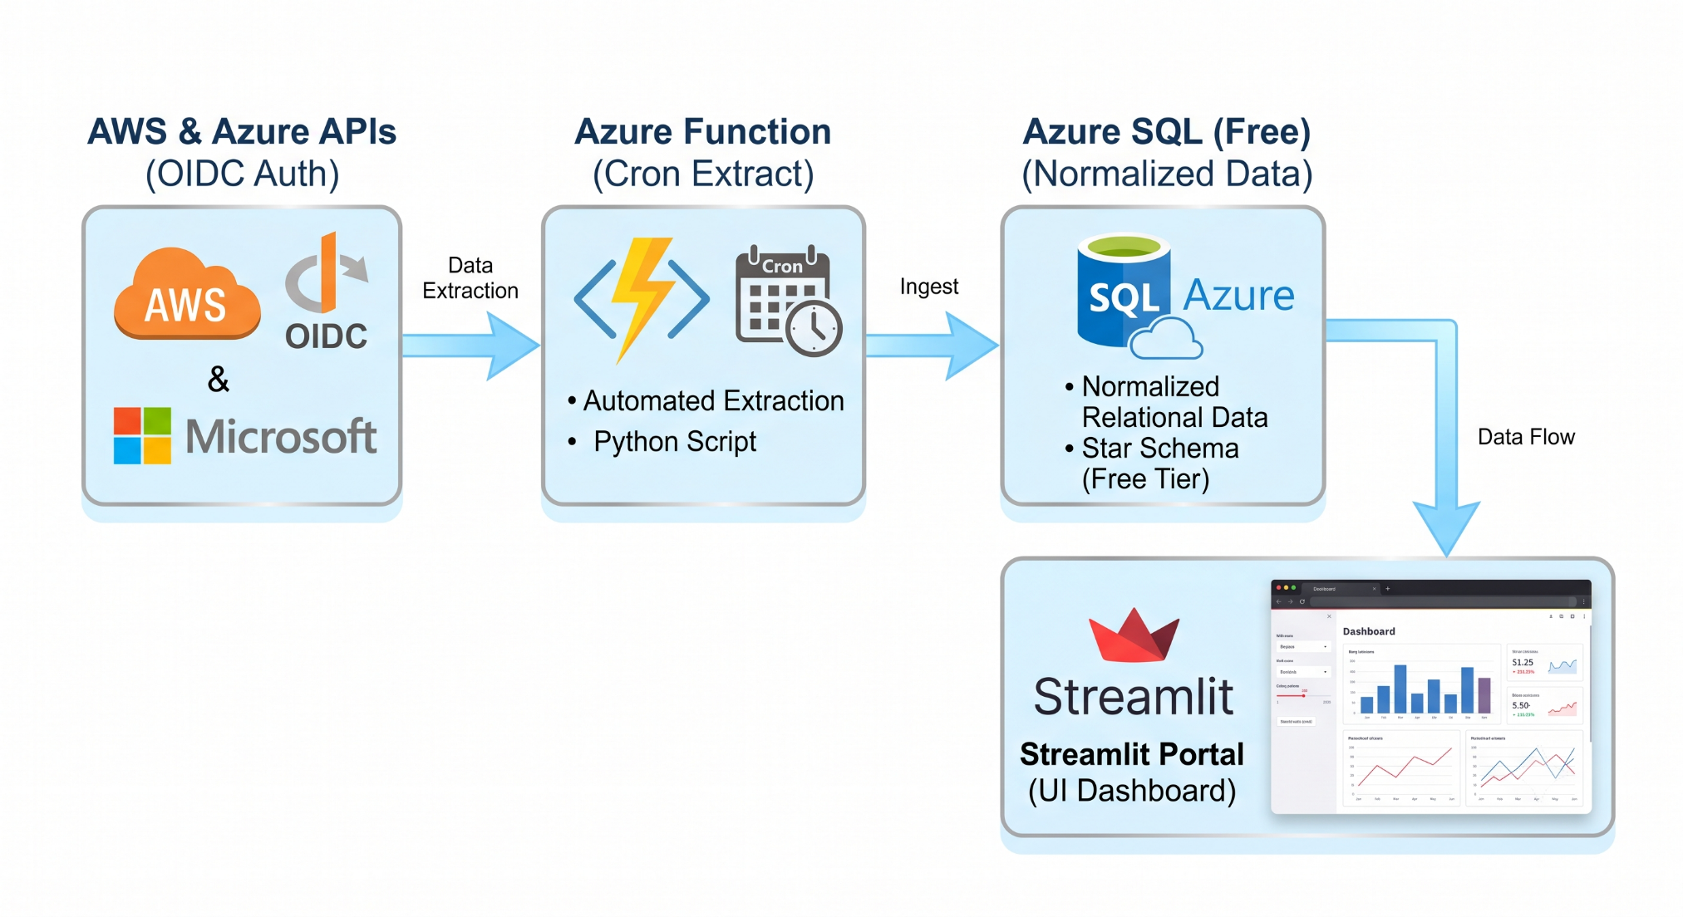
Proposed Solution

Slide 12
System Requirements
Programming Language: Python 3.10+ runtime environment.
Data Processing & ETL: pandas (v2.0+) for data cleaning and structural normalization; numpy for localized mathematical vector operations.
Database Connectivity: SQLAlchemy ORM layer coupled with pyodbc driver extensions for robust connection pooling.
Frontend Dashboard Framework: Streamlit (v1.30+) web framework utilizing native components (streamlit.dataframe, plotly charts) for local data visualization.
Cloud Infrastructure & Compute Resources:
Serverless Execution Engine: Azure Functions runtime (v4.x) running on a Consumption Plan (Serverless Linux/Python environment).
Relational Data Store: Azure SQL Database deployed on the Serverless Compute Tier (General Purpose, Free Tier/Auto-pause enabled) configured with a Star Schema.
Target Cloud Providers: Native AWS Billing/Cost Explorer API endpoints and Azure Cost Management + Billing API datasets.
Security, Identity & Protocol Requirements:
Authentication Mechanism: OpenID Connect (OIDC) via Azure Entra ID Workload Identity Federation linked directly to AWS IAM roles.
Network & Encryption Standards: HTTPS/TLS 1.2+ for all transit API calls; AES-256 transparent data encryption (TDE) enabled on the Azure SQL database.
Data Specification Standard: Full structural compliance with the FinOps Open Cost & Usage Specification (FOCUS) data model schema.

Slide 13
Detailed Scope of Work
Phase 1: Environment Provisioning & Security Federation
Identity Trust Setup: Establish OpenID Connect (OIDC) Workload Identity Federation between AWS IAM and Azure Entra ID to enable passwordless, keyless API access.
Data Warehouse Initialization: Deploy the Azure SQL Database (Serverless Tier) and execute DDL scripts to build the specialized Star Schema (Fact and Dimension tables).
Phase 2: ETL Pipeline & Ingestion Engineering
Schema Mapping Engine: Develop the Python parsing components utilizing pandas to ingest and map disparate vendor billing APIs (AWS Cost Explorer & Azure Cost Management) into a unified FOCUS-compliant format.
Data Transformation: Code the mathematical validation layer to handle currency normalization, timestamp synchronization, and multi-cloud account mapping.
Phase 3: Serverless Deployment & Automation
Function App Packaging: Containerize or package the Python ETL runtime into an Azure Functions deployment package.
Orchestration Scheduling: Deploy the pipeline to the Azure Functions Consumption Plan and configure automated CRON execution via host.json for daily automated delta loads.
Phase 4: Dashboard Analytics & Governance Testing
Streamlit Interface Assembly: Connect the Streamlit UI framework to the Azure SQL backend via SQLAlchemy connection pooling to display live metrics.
Reconciliation & Validation Engine: Execute end-to-end integration testing using a "Waterfall" reconciliation algorithm to ensure active detection of orphaned storage elements, idle compute, and rate leakages.

Slide 14
References
[1] M. S. de Brito, A. Hoeller, and T. M. Sucha, "Automated Cloud Cost Optimization: A Systematic Literature Review," IEEE Access, vol. 11, pp. 114002–114018, 2023.
[2] S. Dustdar, S. N. Srirama, and A. M. El-Rify, "Governance Frameworks for Multi-Cloud and Hybrid Cloud Topographies," IEEE Cloud Computing, vol. 9, no. 4, pp. 22–31, 2022.
[3] Y. Ju, V. C. M. Leung, and X. Wang, "Event-Driven Serverless Architectures for Near Real-Time Infrastructure Compliance Verification," IEEE Transactions on Services Computing, vol. 16, no. 2, pp. 845–858, 2023.
[4] J. Opara-Martins, R. Sahandi, and F. Tian, "Critical Analysis of Vendor Lock-In Strategies and Resource Lineage in Multi-Cloud Governance," IEEE Systems Journal, vol. 14, no. 3, pp. 3142–3153, 2020.

Slide 15


